Slide 1
Market Update, 9/19
Quant Lab
Israel Diego

Slide 2
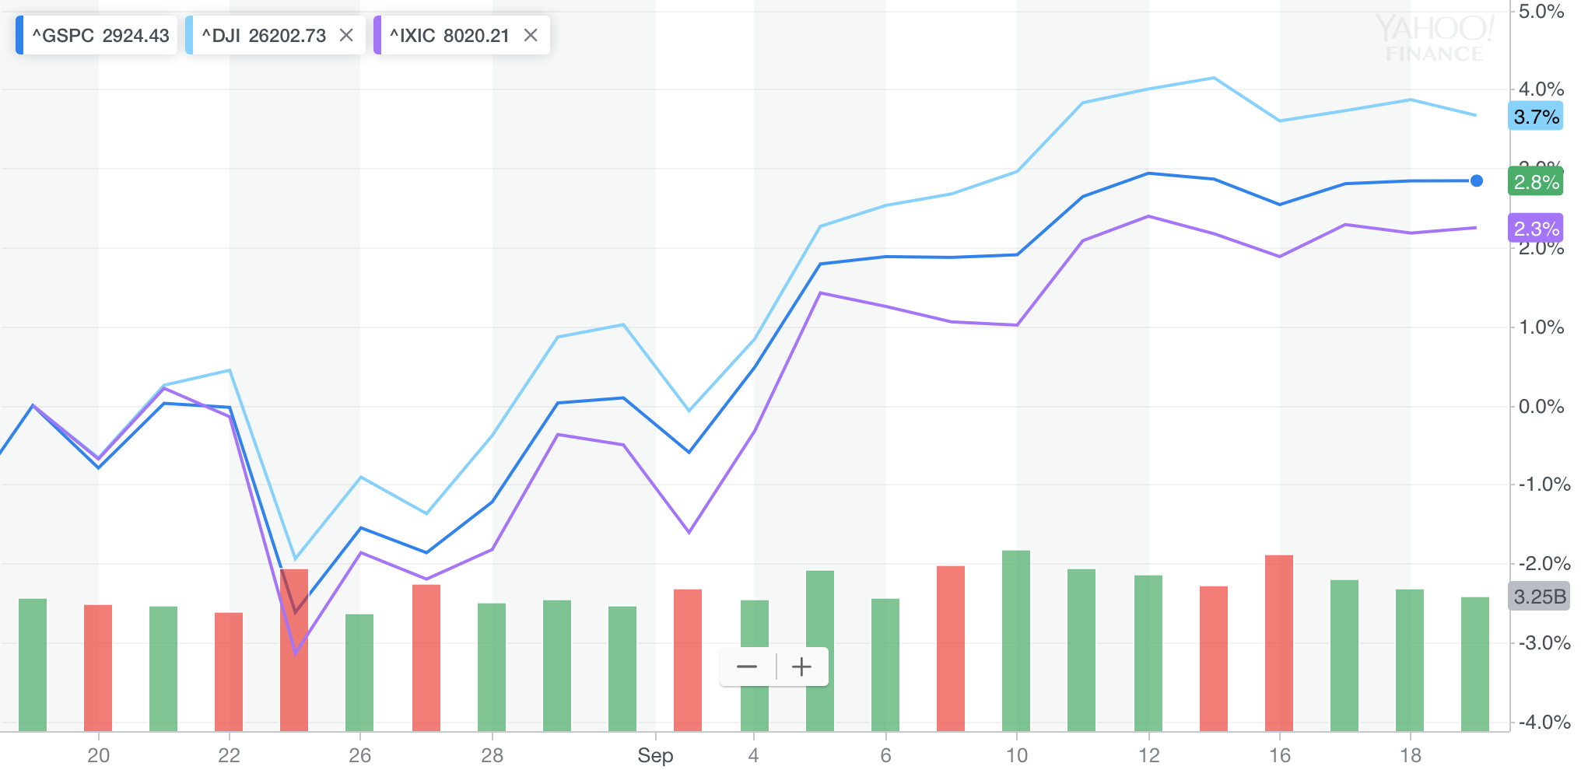
What happened this week?

Slide 3
Sept 16th:
Stocks tumble after an 8-day stretch of gains. Crude oil drove most of the market downward after a series of attacks on two of the world’s largest oil processing facilities in Saudi Arabia. Oil production shut down to half of production (5% world’s daily oil production).
Crude oil prices also increased >10% after the attacks
Airline companies were also affected by the increase in oil price
Sept 17th:
Energy companies were big lag in the market.
Saudi King Salman says oil production will return to normal by the end of the month.
Oil prices fell by 5%
Utilities and homebuilding stocks were up in the market, while retail/metals/mining/banks stocks were down.
Sept 18th:
Fed lowered its target for federal funds rate from 2% to 1.75%. No signal of further rate cuts. Projections for inflation and growth unchanged.
Fed states it will cut interest rates further if a market downturn occurs.
Bond yields are up
Sept 19th :
Trade talks are still key mover in stocks. Trump states he is willing to raise tariffs further if trade talks won’t settle.

Slide 4
News Links
Fed Cuts Interest Rates
Saudi Arabia set to return to normal oil production
China talks resume

